Slide 1
CLOUDERA ALTUS DEMO

Slide 2

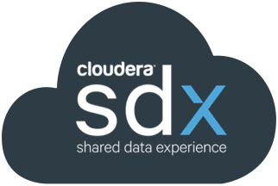
CLOUDERA ALTUS
MULTI FUNCTION
DATA ENGINEERING
ANALYTIC DB
SECURITY
GOVERNANCE
WORKLOAD MANAGEMENT
INGEST & REPLICATION
‹#›
Platform-as-a-Service with Shared Data Experience
DATA CATALOG
MULTI CLOUD
Amazon S3
Microsoft ADLS

Slide 3




Cloudera Altus Architecture
Customer Cloud
CLI
Compute
Storage
ALTUS
CONTROL
PLANE
ALTUS DATA ENGINEERING
Web
ALTUS ANALYTIC DATABASE
SDK

Slide 4
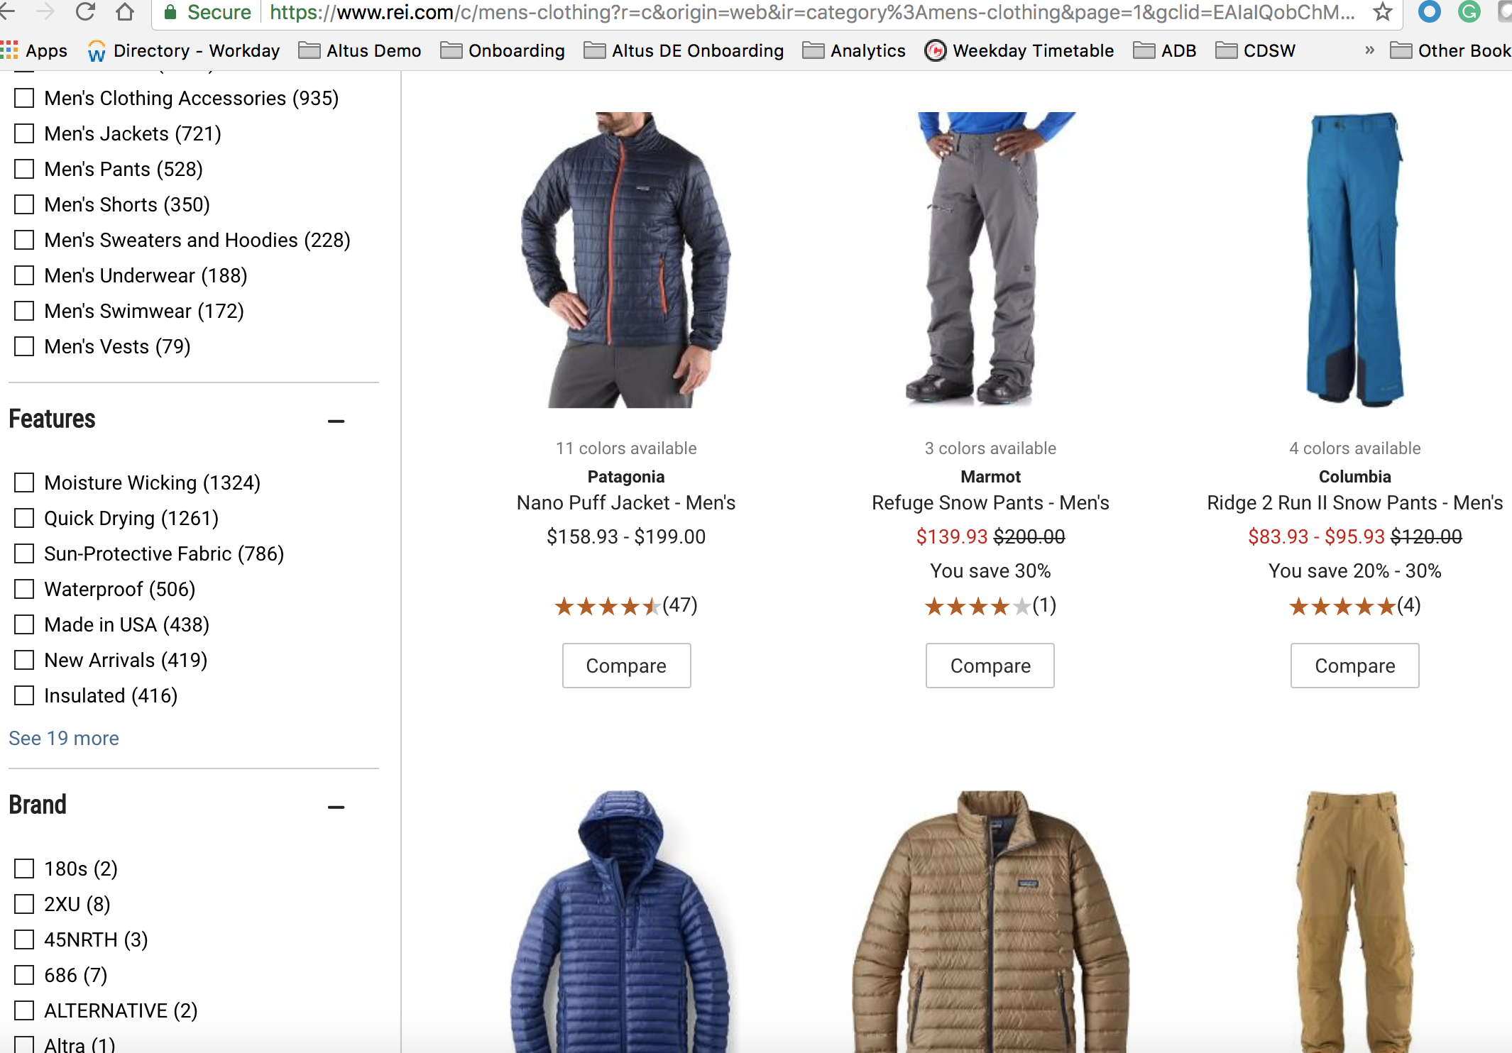
RETAIL DEMO
The Problem
Website sales are struggling
How to figure whether sales orders correlate with website visits?
Business Analyst/Data Scientist
Analysis
Develop insights
Build models
Solve business problem

Slide 5

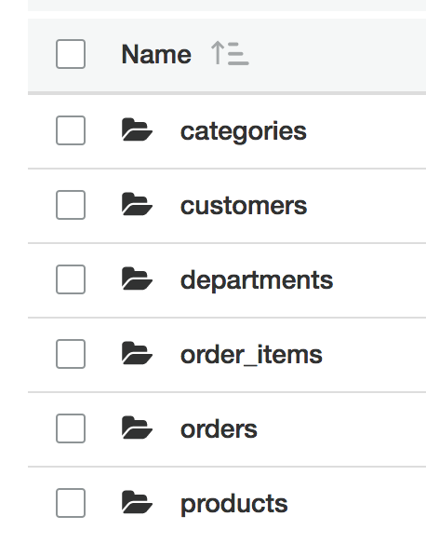
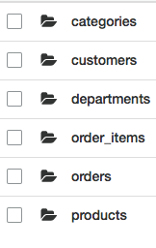
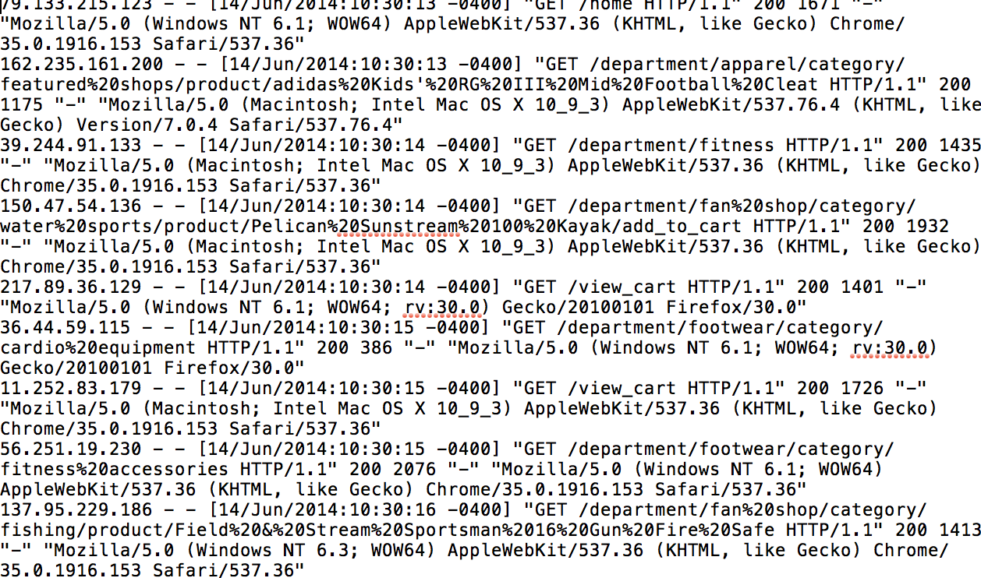

RETAIL DEMO
Sales Order
Clickstream Weblogs
Data Engineer
Develops, tests, maintains large scale data processing systems

Slide 6
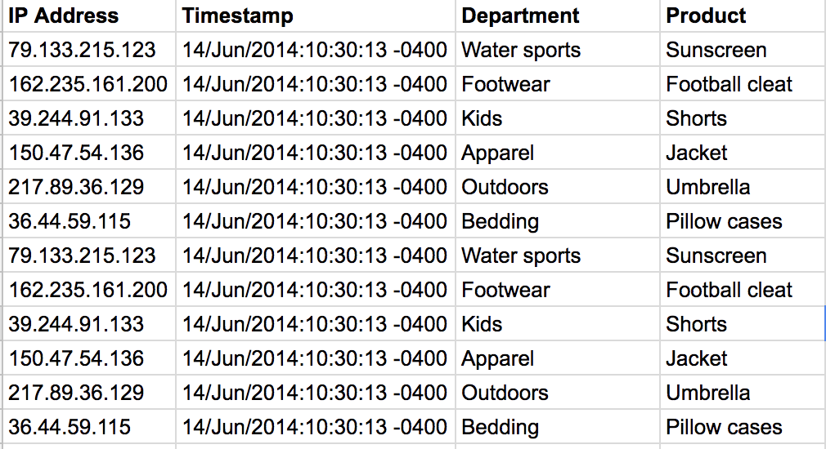
RETAIL DEMO
ALTUS DATA ENGINEERING
Altus SDX
Sales Order
Clickstream Weblogs
Tokenized Logs

Slide 7
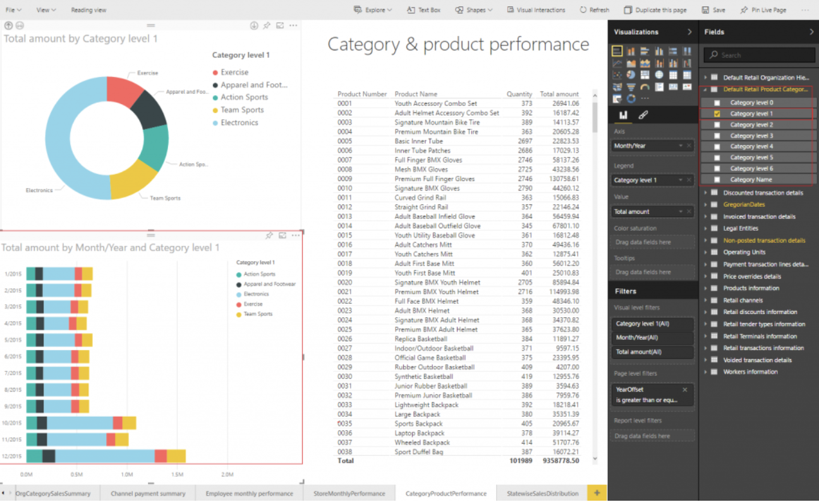
RETAIL DEMO
ALTUS DATA ENGINEERING
ALTUS ANALYTIC DATABASE
Altus SDX
BI DASHBOARDS
Sales Order
Clickstream Weblogs
Tokenized Logs

Slide 8
WHAT’S NEXT?
“The website team wants to use this data too but I don't want them in my cluster slowing me down. What should I tell them?”
— Analyst
“I had to wait 5 hours for that new weblog data to merge into my data mart. I don't want to wait that long. Can we do this faster? Will it cost me more?”
— Data Engineer
“We’ve using a new cloud provider. But I don't want to learn a whole new set of tools and concepts.”
— Admin

Slide 9
OBJECTIONS
“This demo looked simple but what did it take to set things up in the first place? Can you handle the complexity of our environment?” — Admin
“We have strict security requirements. Can you support them? How hard are they to set up?”
— Infosec

Slide 10
PRIMARY WORKLOADS IN THE CLOUD
Only pay for what you need, when you need it
Fast, easy job submission
No cluster management
Built-in Workload
Lower costs with transient resources
Full benefits of resource isolation
Self-service flexibility at any scale
Fast, easy, automated cluster management
Long running, multi-tenant Impala cluster
Lower costs with pay-per-use pricing
Full benefits of resource isolation
ALTUS DATA ENGINEERING
ALTUS ANALYTIC DATABASE
Altus SDX
Shared Open Storage

Slide 11
HOW TO DEMO ALTUS SDX
You create a namespace in parallel with an environment
Associate the namespace with DE cluster when you spin it up
Run hive job on DE cluster (remember to include any DDL statements as well in the script)
Associate same namespace with ADB cluster when you spin it up
Open up Hue on the ADB cluster and look what's in the default table - Voila!

Slide 12
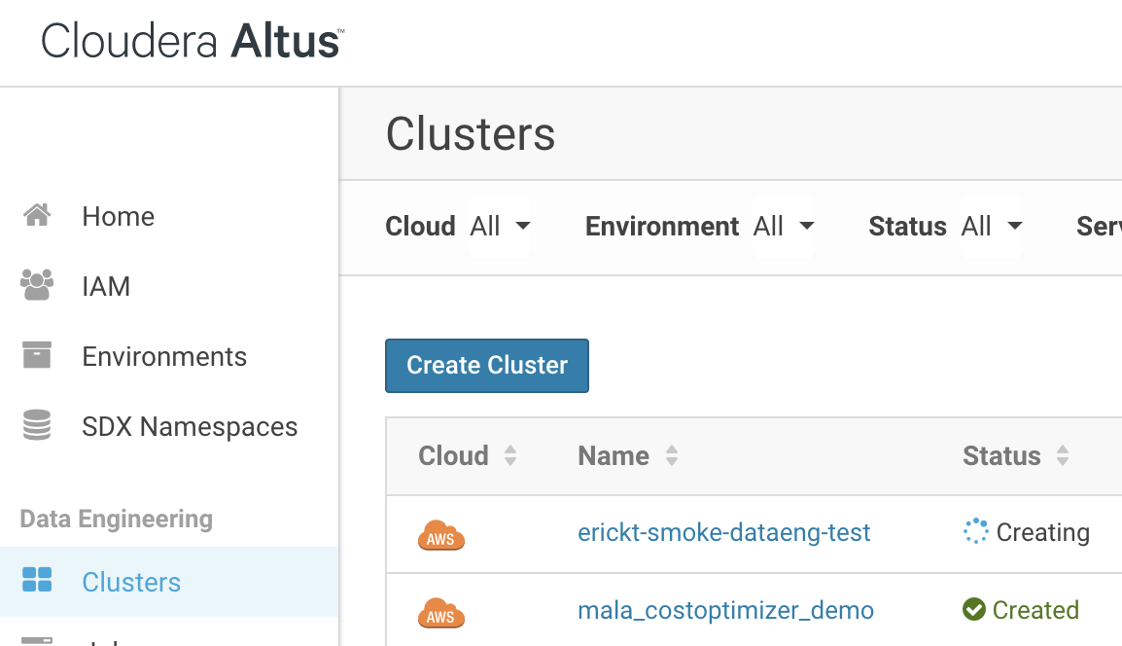
CLOUDERA ALTUS - SELF-SERVICE FREE TRIAL
Our customers want choices
Everything you don’t have to do:
Install any software
Install any hardware
Worry about cluster configuration
Upgrade/re-configure clusters
OS upgrades/patching
Resource Management
30 day free trial*
*Subject to terms and conditions

